Slide 1

Rendering Lightning
Course : Advanced Graphics(CS775)
Instructor: Parag Chaudhuri
Year: 2020

Slide 2
Team
Manas Shukla
Roll no. : 170050066
Email: manasshukla@cse.iitb.ac.in
Debabrata Mandal
Roll no.: 170050073
Email:
debman@cse.iitb.ac.in

Slide 3
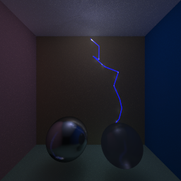
Overview
Simulating Physics and Maths based Lightning effects.
Dielectric Breakdown Model
Stochastic Model

Slide 4
Motivation
Fascinating lightning phenomena around us
Use the power of Computer Graphics to see these virtually.

Slide 5
Modelling Lightning
1

Slide 6
Physics Based
Use physics equation of electrostatic field of charges to generate lightning.

Slide 7
Dielectric BreakDown Model
DBM (also known as 𝜂-model) is a way to simulate Laplacian Growth.
As part of the model, need to solve the Laplace Equation:
One solution : - Dividing the grid into cells and solving a linear system using the boundary conditions
An easier way is to get a solution by considering the medium insulating and placing charges at specific positions to still get a valid solution.
∇²ø = 0

Slide 8
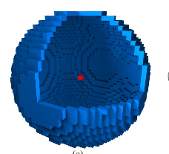
Laplace solution (faster version)
Instead of solving the Laplace equation using potentials, place charges at positions that give the boundary conditions that is required.
Eg.
Boundary condition Ø=0 at centre and Ø=1 at the boundary
Potential due to the negative charge placed at centre :- ø ∝ (1 - R/r)
R - Sphere Radius, r - distance of point from centre
Same solution can be achieved by placing positive charges on periphery and a negative at centre

Slide 9
Probabilistic sampling candidate sites
Equation :-
P_{i} = Probability associated with site i
Ø_{i} = Potential at i^{th} site
𝜂 = the parameter which controls the branching from the parent arc
P_{i} =( Ø_{i} )^{𝜂} / Σ _{j=1..n} ( Ø_{j} )^{𝜂}

Slide 10
Dielectric BreakDown Model
Check for terminating condition
01
Find next candidate site
05
Flow at every iteration
02
Update potential at every candidate site
Add charge at candidate site
04
03
Add its neighbourhood to the candidate set

Slide 11
Breakdown at positive sites (upward connecting arcs)
Simulate the dielectric breakdown at the positive sites
Choose an E_{break} for the positive breakdown candidates
Let the algorithm at positive breakdown according to same rules as negative discharge
Modify the terminating condition of the original algorithm

Slide 12
Maths Based
Use random process to generate arcs.

Slide 13
Stochastic Model
Creating strikes one after another starting from a given point towards a given plane.
Given a point (x,y,z) we get (x’,y’,z’) as
x’ = x + R.sin(Θ).cos(𝜙)
y’ = y - R.sin(Θ).sin(𝜙)
z’ = z + R.cos(Θ)
Where Θ and 𝜙 are randomly drawn from [0,𝜋/2] and [0,2𝜋].

Slide 14
Algorithm
Choose last point as (x,y,z)
Exit the loop if boundary reached
Init last point as origin
Calculate (x’,y’,z’) and set it as last point
Sample θ and 𝜙

Slide 15
Implementation
2

Slide 16
Rasterization
Three Js Framework
Fast Rendering
Supports Animation
Using Physics Model.

Slide 17
Rendering Arcs
Use cylinder to render arcs.
Path that hits boundary is main channel(thick) and rest are secondary(thin).
Apply bloom pass to smoothen the light.

Slide 18
Workflow
Setup Scene
Init the Arc System
Update the System
Setup camera and light . Add any model to scene. Add layers to camera (one for arcs other for model)
Create an instance of Arc System. Initialise its charges and candidate sites.
Generate arcs at a certain speed. When boundary is hit re-init the arc system.

Slide 19
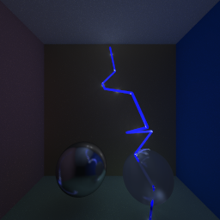
Ray Tracing
Slow but more realistic.
Scene is lighted up by Arcs.
Using Stochastic Model

Slide 20
Rendering Arcs
Arcs are cylinder objects.
Also we use them as light source to light up the scene.

Slide 21
Workflow
Setup Scene
Add the arcs to scene
Perform Ray tracing
Add objects,materials and light to the scene from xml file.
Generate the arcs from stochastic model. Add the corresponding objects and light to scene.
Run the ray tracing loop and save the result to an image file..

Slide 22
References
Project Repo(Private Classroom)
Main Paper
ThreeJs
Stochastic Method
Ray Cylinder Intersection

Slide 23
TEMPLATE CREDITS
Special thanks to all the people who made and released these awesome resources for free:
Presentation template by SlidesCarnival
Photographs by Unsplash

Slide 24
THANKS!
ANY QUESTIONS?

